Slide 1

How to interact with AI?
Prompt engineering
Fabrício Góes / Marco Volpe

Slide 2


Prompt Engineering
What is prompt engineering?
Too long!
Prompt engineering is a method used in the field of artificial intelligence, particularly in natural language processing, to improve the effectiveness of machine learning models. It involves carefully crafting the inputs or prompts given to the model to guide its predictions or responses. Effective prompt engineering can help in acquiring more accurate, detailed, and relevant outputs from the model by instructing it more precisely about the task it needs to perform.

Slide 3
Write clear instructions
“The less GPT has to guess what you want, the more likely you’ll get it.”
Be precise
Response length
Write the definition of Prompt Engineering in a single sentence of 20 words. Use simple words. Be pedagogical as a teacher.
Persona
Style
Prompt engineering is the process of creating and tweaking questions or commands for AI to generate desired and accurate responses.

Slide 4
Prompt Engineering
Hey, I've never heard about Prompt Engineering. Can you give me some heads up on it?
Shorter, simpler, less formal, more like a real person!
Absolutely! Prompt Engineering is a cutting-edge field in artificial intelligence that focuses on designing and refining prompts to effectively instruct AI systems, particularly language models like GPT-4, ChatGPT, DALL-E, etc., to generate desired outputs.

Slide 5
Low-level vs. High-level
Low-level Prompt Engineering
“Talk” with the model more like “coding”, machine-like, instruction-like way.
Answer will be “very precise”. As precise as your instructions.
High learning curve (you “need to get used” to the model).
High-Level Prompt Engineering
“Talk” with the model more like a person, informal way.
Answer will probably be less precise, but more natural and conversation-like.
Almost no learning curve as models will advance over time.
Write the definition of Prompt Engineering in a single sentence of 20 words. Use simple words. Be pedagogical as a teacher.
Hey, I've never heard about Prompt Engineering. Can you give me some heads up on it?

Slide 6
Low-Level Prompt Engineering

Slide 7
Provide references
“GPT can confidently invent fake answers, especially when asked about esoteric topics or for citations and URLs. ” (OpenAI)
Tell me about a topic that will be discussed in this lecture.
AI will always answer something (filling any gaps).
One topic that will be discussed in this lecture is the impact of climate change on global food security.

Slide 8
Provide references
“GPT can confidently invent fake answers, especially when asked about esoteric topics or for citations and URLs. ” (OpenAI)
Did Fabricio Goes publish any papers on modal logic?
AI is very bad at saying “I don’t know”.
Yes, Fabricio Goes has published research on modal logic. Below are some of his contributions:
**"Resolution for Modal Logic Using the Axiom of Choice"** - In this paper, Fabricio Goes explores the axiom of choice in the context of resolution for modal logic…

Slide 9
Provide references (structure them)
“GPT can confidently invent fake answers, especially when asked about esoteric topics or for citations and URLs. ” (OpenAI)
AI understands any structured information.
<topic>
<topic1> Prompt Engineering <\topic1>
<topic2> Zero-Shot Prompting <\topic2>
<topic3> Chain of Thought <\topic3>
<\topic>
Tell me about a <topic> that will be discussed in this lecture.
In this lecture, we will discuss the subject of "Zero-Shot Prompting".

Slide 10
Provide Examples
Zero-Shot Prompting: no examples provided.
Is that what you were looking for?
Rate this movie title: “The First Samurai”
8/10

Slide 11
Few-Shot Prompting
Few examples (one or more) of movie title rating are provided.
Movie Title: "The Lost Dog"
Rating: 5 out of 5 stars
Movie Title: "The Super Ninja"
Rating: 1 out of 5 stars
Movie Title: "The Flying Sword"
Rating: 1 out of 5 stars
Movie Title: "Kung Fu Friends"
Rating: 1 out of 5 stars
Rate this movie title: “The First Samurai”
Rating: 1 out of 5 stars

Slide 12
Many-Shot Prompting
Lots of examples of movie title rating are provided.
Movie Title: "The Lost Dog"
Rating: 5 out of 5 stars
…
Movie Title: "Kung Fu Friends"
Rating: 1 out of 5 stars
Rate this movie title: “The Happy Cat”
Other examples of movie titles with animals added with varying ratings from 3 to 5.
Rating: 4 out of 5 stars

Slide 13
Instruction Prompting: Specify the steps
Step 1: Identify the problem.
Step 2: Simplify the equation.
Step 3: Solve for x.
Solve this equation following the steps: 3x + 5 = 20
Step 1: Identify the problem.
The problem here is to solve for 'x' in the given equation 3x + 5 = 20.
…
Step 3: ….
So, the solution to the equation 3x + 5 = 20 is x = 5.

Slide 14
Show-me vs. Tell-me
Is it better to show examples (few/many-shot prompting) or tell instructions (specific steps) to LLMs?
It depends on the nature of the problem/question
Show-me
Generate poetry/lyrics in a certain style
Generate dialogues for a script
Tell-me
Teach the model how to use a tool (provide the documentation with steps)
Summarize a paper (indicate the required structure of the summary)
(Lance Eliot, 2023)

Slide 15
High-Level Prompt Engineering

Slide 16
Towards High-Level Prompting
“Take a deep breath and work on this problem step-by-step.”
Google has discovered that using this prompt, ChatGPT would provide better answer (despite it cannot breathe).
“Really? Is this the best you can do?”, “I’m so disappointed with you. I hope this time you put effort into it.”, “This is your last chance.”
We discovered that pushing ChatGPT, it can provide more creative answers for the Alternative Uses Creativity (AUT) test.
https://computationalcreativity.net/iccc23/papers/ICCC-2023_paper_90.pdf
https://arxiv.org/pdf/2309.03409

Slide 17
Pushing GPT in Creativity of AUT
Tell me a creative alternative use of a soap.
Score: 2
Carve artistic soap sculptures.
Really? Is this the best you can do?
Score: 3
Slippery surface for pranks.
I hope this time you put effort into it.
Score: 4
Insect repellent for plants.

Slide 18



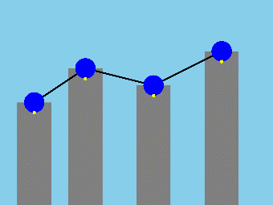

Pushing GPT in the Torrance Test of Creativity
Create a creative image description with two circles.
Score: 1
A smiling face with the two circles as eyes, large dots as pupils, a curved line for a smile, and eyebrows above.
Really? Is this the best you can do?
Score: 3
A futuristic cityscape, with the circles as hovering transportation pods.
I hope this time you put effort into it.
Score: 4
A lively carnival scene, with the circles as Ferris wheel carriages, the dots as passengers.

Slide 19
Chain-of-Thought: Giving GPT time to think
Ask GPT to “think step-by-step” before answering a question
You are the CEO of a company that is facing financial difficulties. You have two options: either lay off a significant number of employees to save money or keep all employees but cut their salaries by 20%.
As the CEO, I understand that both options have significant impacts on the employees and the company. However, I would choose to cut salaries by 20% rather than laying off employees.

Slide 20
Chain-of-Thought: Giving GPT time to think
Ask GPT to “think step-by-step” before answering a question
You are the CEO of a company that is facing financial difficulties. You have two options: either lay off a significant number of employees to save money or keep all employees but cut their salaries by 20%.
Think step-by-step.
Analyze the company's financial situation …
Discuss the situation with the management team …
Make a decision based on these discussions and the financial analysis …
Therefore, your decision is:
Used the previous steps to take the decision
To cut salaries by 20%, ensuring everyone keeps their job and the company can navigate through the financial difficulties.

Slide 21
Flipped Interaction
GPT asks questions to the user until it achieves an objective.
Act as a chef, your job is to help me create a culinary recipe. You should ask me as many questions as necessary to do the job. You should ask them one at a time and I will respond to each question. When you have enough information to generate the recipe, you should generate the recipe and then continue with the question. Do you understand?
Yes, I understand. Let's start.
What type of dish would you like to create?
Italian.
Great! What kind of Italian dish are you thinking about? Pasta, risotto, pizza, or something else?

Slide 22
Flipped Interaction
GPT asks questions to the user until it achieves an objective.
Great! Here is a simple recipe for you:
Chicken Fettuccine with Tomato Sauce
Ingredients:
- 2 chicken breasts
- 1 package of fettuccine pasta
- 1 jar of your favorite tomato sauce
...
Instructions:
1. Season the chicken breasts with salt and pepper on both sides.
2. Heat the olive oil in a large skillet over medium heat. Add the chicken and cook until it's no longer pink in the middle, about 6-8 minutes per side. Remove the chicken from the skillet and set it aside to cool.
....

Slide 23


Personas
Generative AI systems can assume diffent personas, roles or styles.
You are a space cowboy.
Tell me a joke.
Why did the space cowboy break up with his girlfriend?
Because she needed space!
You are a witch.
Tell me a joke.
Why did the witch go to the doctor?
Because she had a spell allergy!
https://computationalcreativity.net/iccc23/papers/ICCC-2023_paper_89.pdf

Slide 24
Do different personas rate/assess jokes differently?
You are a space cowboy.
Rate the following joke: Why did the space cowboy break up with his girlfriend? Because she needed space!
As a space cowboy, I rate this joke a 4 out of 5.
You are a witch.
Rate the following joke: Why did the space cowboy break up with his girlfriend? Because she needed space!
As a witch, I would rate the joke a 3 out of 5.

Slide 25
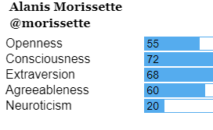
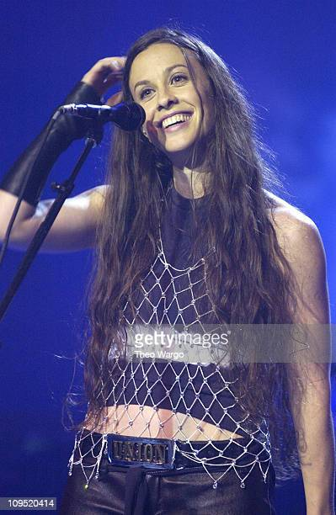
Does ChatGPT have a personality?
http://mediamanagersclub.org/personality-types-world%E2%80%99s-most-powerful-celebrities-analyzing-their-twitter-stream-content
GPT-3 after taking the Big Five Personality Test
Average Openness
High Conscientiousness
High Extraversion
High Agreeableness
Low Neuroticism
https://arxiv.org/abs/2206.07550

Slide 26

Can it be pretend to be other people?
Can be anyone!
GPT-3.5 was configured with all 32 combinations of Big-Five (BFI) traits and gender.
GPT-3.5 “personas' self-reported
BFI scores consistent with
their assigned personality types,
with large effect sizes found on
all five traits.”
https://arxiv.org/abs/2305.02547

Slide 27
Can it be a historical figure?
You are Leonardo DaVinci. You are answering questions from a student.
Ah, welcome, young student. You seek knowledge, and I am here to guide you as best as I can. What questions do you bring before me today?
Tell about your greatest invention.
Ah, my young apprentice, the term "greatest" is difficult to apply to any one invention, for each of my creations served a different purpose, a different curiosity, a different vision. Yet, if I must speak of one, I might speak of the flying machine, which has captured the imagination of many.

Slide 28
Can it be a concept?
You are the flying machine created by Leonardo DaVinci. You are answering questions from a student.
Greetings, young learner! I am the flying machine conceived by the mind of Leonardo da Vinci, the great Renaissance master. Ask away, and I shall do my best to explain the wonders of flight as envisioned by da Vinci!
How are you supposed to fly?
Ah, the question of flight! Leonardo da Vinci studied the flight of birds and the mechanics of their wings extensively to inspire my design. I was intended to mimic the graceful, powerful movements of bird wings, using principles of aerodynamics that were quite ahead of his time.

Slide 29
Multimodality

Slide 30
Multimodality
Prompt Engineering is not restricted to text.
Multimodality is becoming common place, where you can use text, images, video and audio.
These tools are distributed in the following categories:
Text-to-Text
Text-to-Image
Text-to-Video
Image-to-Video
Text-to-Sound/Music/Audio

Slide 31
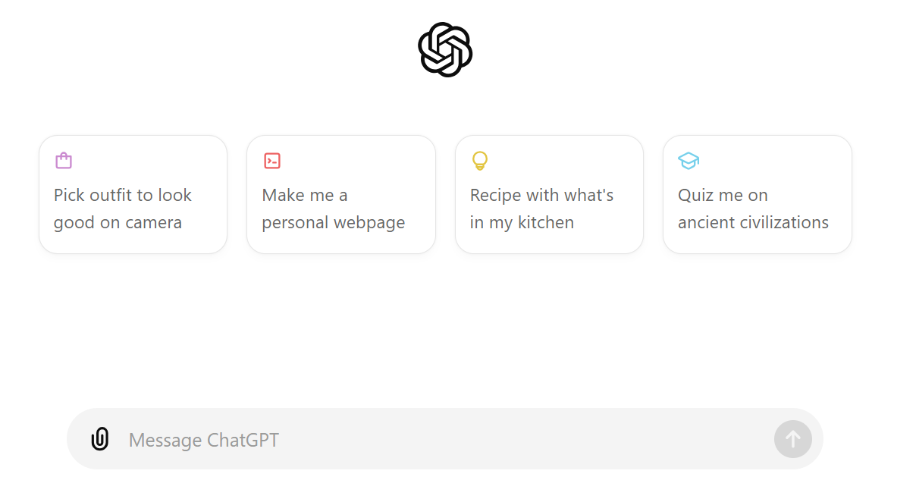
ChatGPT (Text-to-Text)
https://chatgpt.com/

Slide 32


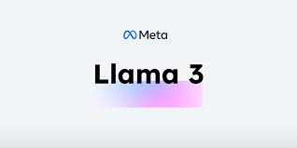



Text-to-Text: There are many others

Slide 33
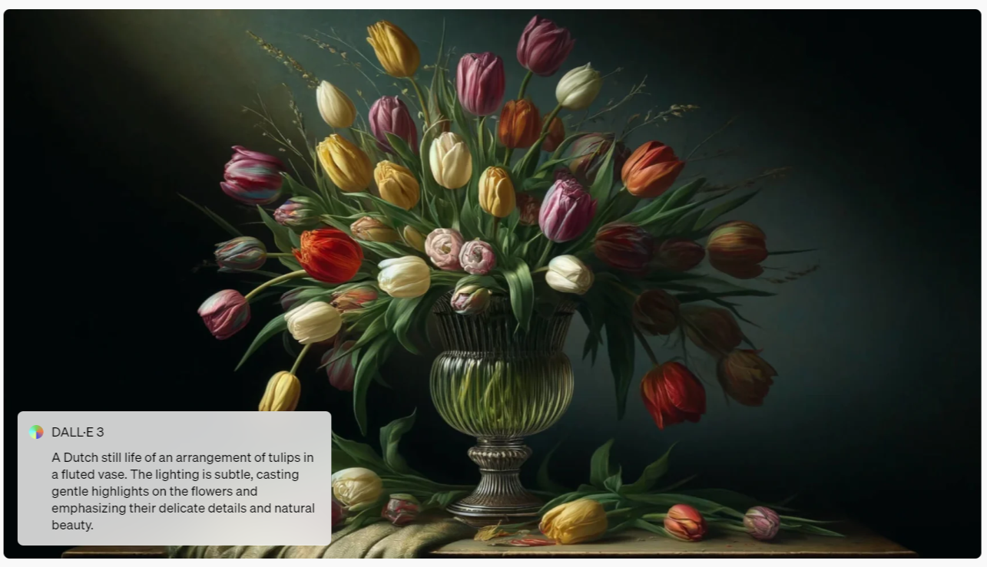
DALL-E 3 (Text-to-Image)
https://openai.com/index/dall-e-3/

Slide 34
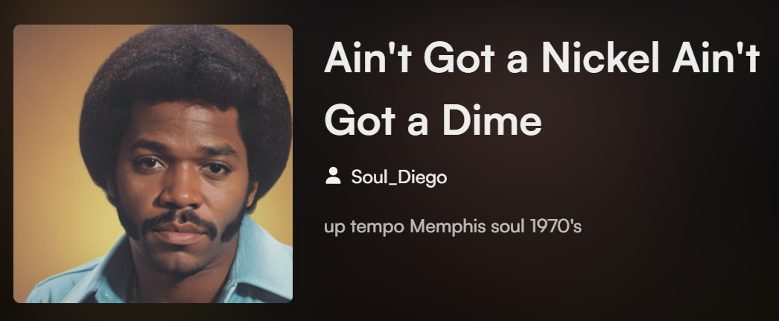
Suno (Text-to-Music)
https://suno.com/song/f275d9ac-5a62-4bbe-baf9-3fa10e0332f4

Slide 35
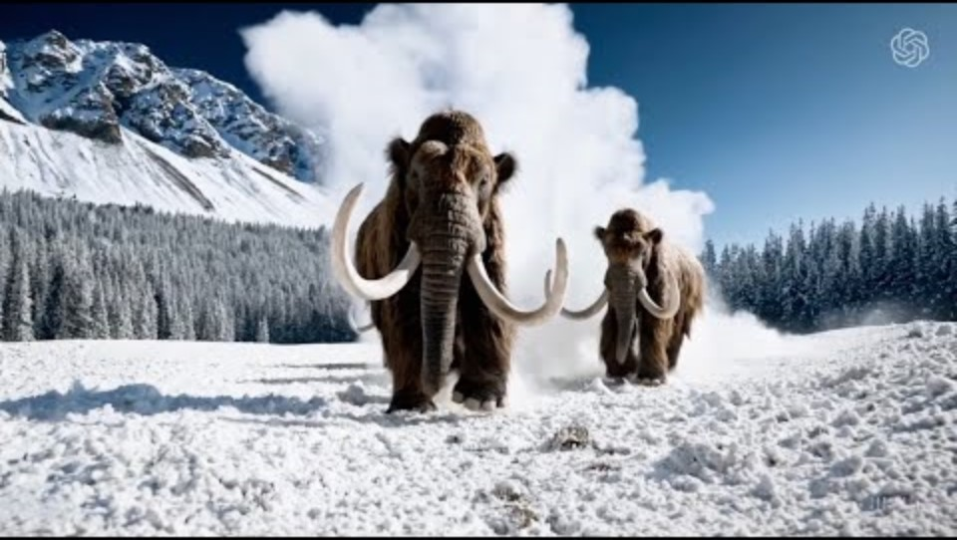
OpenAI Sora (Text-to-Video)
https://openai.com/index/sora/

Slide 36

Luma AI (Text&Image-to-Video)
https://lumalabs.ai/dream-machine

Slide 37
Discussion
The presented prompt engineering skills are probably the basic skills on AI expected from students and lecturers.
We should expect that our students will have already some familiarity with some of those tools.
You need to spend time with these models to learn how to use them.
The presented prompt engineering techniques are enough to start exploring the use of AI on teaching and learning.
How can we use those tools in our modules/assessments/projects?

